Slide 1

SiteBuilder AI –Drag and Drop Website Creation with Generative AI
Group No. 3
Project Guide
Ms. Sarala Mary /Ms. Richa Singh
Student ID | Group member
21107048 | Veena Sharma
21107066 | Sanika Shelke
21107056 | Ridhvik Thakur
21107052 | Montu Suthar

Slide 2
Contents
Abstract
Introduction
Objectives
Literature Review
Research Gap
Problem Definition
Scope
Technological Stack
Proposed System Architecture/Working
Prototype Design Demonstration
Implementation Status
Review Suggestions (Given in Last meeting)

Slide 3
Abstract
Creating a website can be overwhelming for individuals and small businesses due to the need for coding expertise and high costs associated with professional web development. The Website Builder addresses these challenges by offering a user-friendly, drag-and-drop platform that allows users to create fully functional websites without any coding knowledge. Utilizing pre-designed templates and customizable layout options, users can quickly build and manage their websites according to their preferences. The platform also simplifies content management, enabling seamless editing of text and images. By empowering users to take control of their online presence, the Website Builder ensures an efficient and accessible web development experience for all.

Slide 4
Introduction
In today’s digital age, individuals and businesses require a strong online presence to succeed, yet many face obstacles in creating professional websites due to the technical complexity of traditional methods. Standard website builders and manual coding often fail to bridge the gap between creativity and technical ability, leaving those without coding expertise or significant financial resources at a disadvantage.
Motivation
Traditional website creation methods are complex, time-consuming, and inaccessible to a large portion of users. Many existing solutions lack the customization options needed to reflect personal or business vision, and often require substantial technical knowledge, creating a barrier to entry.
SiteBuilder AI addresses these challenges by offering a revolutionary, AI-powered platform designed to simplify website creation. With an intuitive drag-and-drop interface, real-time design assistance, and extensive customization options, SiteBuilder AI empowers anyone—regardless of coding experience—to build stunning, fully functional websites that match their unique vision. By streamlining the process and eliminating technical barriers, SiteBuilder AI democratizes website creation and makes it accessible to all.

Slide 5
Objectives
To develop a drag-and-drop website builder with AI design assistance using Grape js, allowing users to create websites without coding.
To enable website customization using JavaScript, Styled Components allowing dynamic styling and personalized user experiences.
To implement an efficient content management system using Headless CMS (Strapi)
To integrate a feature where, whenever HTML code is generated using voice commands or user input, the chatbot displays a live preview of the generated code within the chat interface.

Slide 6
Literature Review
Sr.no | Title | Author(s) | Year | Methodology | Drawback
1 | A Comparative Analysis of Modern Frontend Frameworks for Building Large-Scale Web Applications | John Doe Jane Smith Michael Brown | 2023 | The paper evaluates React, Angular, and Vue frameworks using performance metrics (load time, rendering speed, memory usage) and examines features like component-based architecture and state management through real-world case studies and developer surveys. | The study highlights these drawbacks: React's complexity and steep learning curve, Angular's performance overhead and learning curve, and Vue's smaller ecosystem and inconsistent coding practices.
2 | Automated Code Generation for Web Applications | Irfan Ullah Irum Inayat | 2019 | The paper uses a conceptual model to automatically generate source code for the UI, business, and persistence layers, as well as DDL scripts for the database and UML diagrams. | The approach may require additional manual coding to meet specific requirements, leading to extra development time and effort.
3 | AI-Assisted Web Development: Techniques and Applications | Alex Johnson Priya Patel Michael Lee | 2021 | The paper uses AI to automate code generation, UI design, and content personalization. Machine learning algorithms provide intelligent recommendations, improve user experience, and streamline development by automating repetitive tasks. | The study highlights these drawbacks: high implementation costs, complex integration causing potential disruptions, and AI's lack of human touch and contextual understanding.

Slide 7
Sr.no | Title | Author(s) | Year | Methodology | Drawback
4 | Drag-and-Drop Interfaces in Web Development | Md Abdullah Al Alamin Gias Uddin Sanjay Malakar Sadia Afroz Tameem Haider Anindya Iqbal | 2022 | The paper explores enhancing web development with drag-and-drop interfaces, enabling rapid application development by allowing visual design with minimal coding. It uses data from developer forums and surveys to assess adoption and effectiveness. | The study identifies several drawbacks: drag-and-drop interfaces can lead to inconsistent coding practices, may not be suitable for complex applications, and can limit the flexibility and customization options available to developers.
5 | A Survey on Web Development Frameworks | Devendra Kumar Shukla Akash Maurya Madhav Pal Basu Dev Shivahare | 2020 | This paper presents a comprehensive survey of modern web development frameworks. It evaluates various frameworks based on performance, scalability, and ease of use | some frameworks have steep learning curves, others may suffer from performance issues under heavy load, and certain frameworks might lack sufficient community support and documentation.
6 | Enhancing User Experience in AI-Powered Website Builders | Alice Johnson Robert Lee Emily Davis | 2020 | The study uses a mixed-methods approach, combining user studies and performance metrics to enhance user experience in AI-powered website builders through personalization and adaptive interfaces. | The study faces challenges in predicting user preferences, privacy concerns with data collection, and integrating AI with existing frameworks.

Slide 8
Sr.no | Title | Author(s) | Year | Methodology | Drawback
7 | Template-Based AI for Website Generation | David Miller Sarah Thompson Kevin White | 2019 | The paper evaluates AI algorithms for generating website templates, using case studies and both qualitative and quantitative assessments to measure their effectiveness. | The study notes limitations like limited template customization, issues with uniqueness, and challenges in integrating AI-generated templates with existing tools.
8 | AI and Machine Learning in Web Development: A Survey | Mark Johnson Lisa Wang Ahmed Patel | 2023 | The paper conducts a comprehensive survey of AI and machine learning integration into web development frameworks, including website builders. It reviews existing literature, analyzes current technologies, and evaluates their applications through case studies and performance metrics. | The study highlights high computational requirements for AI and ML models, potential security vulnerabilities in AI-driven web applications, and difficulties in maintaining and updating AI models within web development frameworks..
9 | Security Implications of AI in Web Development | Rachel Green Thomas Clark Priya Singh | 2022 | The paper reviews literature and case studies to identify AI-related security challenges in web development and proposes solutions like best practices and advanced security protocols. | The paper notes the high complexity of implementing security measures, potential new vulnerabilities from AI, and the challenge of keeping up with evolving threats.

Slide 9
Sr.no | Title | Author(s) | Year | Methodology | Drawback
10 | User-Centric Design in AI Website Builders | Anthony Man Leong Wong Chee Weng Khong | 2021 | The paper uses a user-centric design approach, analyzing best practices and pitfalls in AI website builders through case studies and user feedback. | The paper identifies drawbacks such as potential user frustration from limited customization options, difficulty balancing automation with user control, and challenges in ensuring accessibility and inclusivity for all users.
11 | Future Trends in AI-Driven Web Development | Jaakko Sauvola Sasu Tarkoma Mika Klemettinen Jukka Riekki David Doermann | 2024 | The paper conducts a comprehensive survey of future trends and potential advancements in AI-driven web development, including website builders. It reviews current technologies, explores emerging trends, and evaluates their implications through case studies and expert interviews. | The paper highlights drawbacks such as high computational costs, ethical concerns in AI decision-making, and challenges in ensuring security and privacy for AI-driven web applications.
12 | Evaluating the Performance of AI-Based Website Builders | David Miller Sarah Thompson Kevin White | 2020 | The paper evaluates various AI-based website builders by examining their performance, scalability, and user feedback. It uses a combination of performance benchmarks, scalability tests, and user surveys to provide a comprehensive assessment. | The paper highlights drawbacks such as high computational costs, scalability issues with increasing user demands, and mixed user feedback on ease of use and customization options.

Slide 10
Sr.no | Title | Author(s) | Year | Methodology | Drawback
13 | Enhancing Web Development with AI-Powered CMS and SEO Tools | John Doe Jane Smith Emily Johnson | 2022 | The paper provides an overview of how AI-powered CMS and SEO tools can enhance web development, using practical examples. It includes case studies and performance metrics to evaluate the effectiveness of these tools. | High initial setup costs for AI-powered tools. Potential issues with data privacy and security. Complexity in integrating AI tools with existing web development workflows.
14 | Scalable Backend Architectures for AI Website Builders | John Doe, Jane Smith Robert Brown | 2020 | The paper explores scalable backend architectures using distributed databases, microservices, and containerization to support AI-driven website builders, focusing on efficient data management and storage | Implementing these architectures can be costly and complex, requiring advanced infrastructure and skilled personnel. Additionally, managing large volumes of data raises significant privacy and security concerns.
15 | Optimizing SEO with AI in Modern Web Development | Alice Johnson Mark Lee Emily Davis | 2020 | The research explores leveraging AI technologies like natural language processing and machine learning to automate SEO tasks, including keyword research, content optimization, and backlink analysis, to boost search engine rankings | The main drawbacks are the resource-intensive need for continuous adaptation to evolving AI algorithms, their opaque nature leading to unpredictable SEO results, and concerns about fairness and control over digital content visibility.

Slide 11
Research Gap(Limitations of existing systems)
Lack of True Drag-and-Drop Flexibility: Existing systems often have restrictive templates and unintuitive interfaces, making it difficult for non-tech users to fully customize their designs.
Scalability Issues for Growing Websites: As websites grow, they may face slow load times and struggle to add new features due to inefficient backend systems.
Poor User Experience with Multi-Device Compatibility: Websites may not render correctly across different devices, leading to a poor user experience due to the lack of true responsive design.
React.js and Vue.js Offer Better Performance in Real-Time Updates: These frameworks provide efficient state management and reusable components, crucial for real-time updates and dynamic content.
No-Code Platforms Improving, but Still Not Intuitive for Complex Designs: No-code platforms often lack the flexibility for complex designs and can still be challenging for non-technical users.
Integrating AI-Driven Suggestions for Layout Optimization: AI can suggest optimal layouts based on user behavior and automatically adjust design elements to improve aesthetics and functionality.
Integration with Third-Party Services: Many platforms struggle with integrating third-party services such as CRM systems, marketing tools, and analytics, which can limit the functionality and effectiveness of the website.

Slide 12
Problem Definition
The goal of the SiteBuilder AI project is to develop a comprehensive platform that empowers non-technical users to create fully customized websites with ease. Leveraging artificial intelligence, the system will offer intuitive drag-and-drop functionality, AI-driven design suggestions, and seamless e-commerce integration. The platform aims to improve user experience, scalability, and accessibility.
Key points to address:
Intuitive Drag-and-Drop Interface
AI-driven Layout and Content Suggestions
Template and Theme Library
Customization of Layouts and Designs

Slide 13
Scope
Individuals, Businesses and Industries
Small businesses: Creating online stores, landing pages, or company websites.
Freelancers: Building professional portfolios or online resumes.
Artists and creatives: Showcasing their work and selling their products online.
Non-profit organizations: Creating websites to promote their cause and raise funds.
Personal blogs and websites: Sharing thoughts, experiences, and information.
6.Education: Creating online courses, educational resources, or school websites.
7.Marketing and advertising: Designing landing pages, promotional websites, or marketing campaigns.

Slide 14
Technological Stack
Front-end:
Grape js: For building scalable web applications.
JavaScript: Core language for interactivity.
Styled Components: CSS-in-JS for modular styling.
Back-end:
Strapi or Contentful: Headless CMS for managing content delivery.
Additional Technologies:
Web Speech API: For voice recognition capabilities.
Google Cloud Speech-to-Text: Accurate speech-to-text conversion.

Slide 15
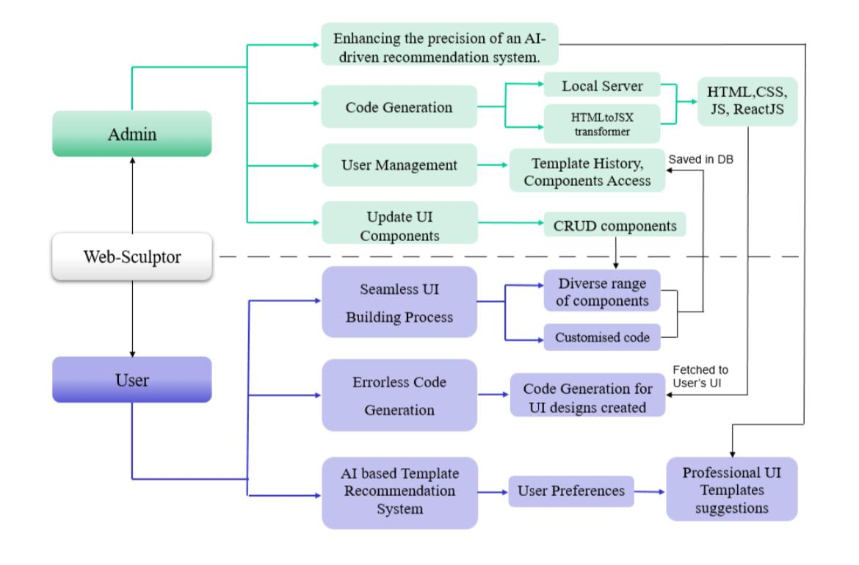
Proposed system architecture/Working
Sitebuilder AI

Slide 16
References
1. Pancham Singh, Mili Srivastava, Mrignainy Kansal, Aditya Pratap Singh,Abhay Chauhan, Adarsh Gaur, A Comparative Analysis of Modern Frontend Frameworks for Building Large-Scale Web Application in IEEE Access, 2023 International Conference on Disruptive Technologies (ICDT)
https://ieeexplore.ieee.org/abstract/document/10150911
2. Irfan Ullah, Irum Inayat, Template-based Automatic code generation for Web application and APIs Using Class Diagram in IEEE Access.2022 International Conference on Frontiers of Information Technology (FIT)
https://ieeexplore.ieee.org/document/10043059
3. Alex Johnson, Priya Patel, Michael Lee,AI-Assisted Web Development: Techniques and Applications, in IEEE Access 2023
https://ieeexplore.ieee.org/abstract/document/10042410
4. Md Abdullah Al Alamin, Gias Uddin, Sanjay Malakar, Sadia Afroz, Tameem Haider, Anindya Iqbal, Drag-and-Drop Interfaces in Web Development, volume 35, pages 461-474, 2022
https://link.springer.com/chapter/10.1007/978-3-540-74796-3_44

Slide 17
5. Devendra Kumar Shukla, Akash Maurya, Madhav Pal, Basu Dev Shivahare,
A Survey on Web Development Frameworks, Constructing the Infrastructure for the Knowledge Economy, pages 495-505 https://link.springer.com/chapter/10.1007/978-1-4757-4852-9_37
6. Alice Johnson, Robert Lee, Emily Davis, Enhancing User Experience in AI-Powered Website Builders, Published in: IEEE Access Volume: 10, DOI: 10.1109/ACCESS.2022.3173289, 2020
https://ieeexplore.ieee.org/document/9770797
7. Mark Johnson, Lisa Wang, Ahmed Patel, AI and Machine Learning in Web Development: A Survey, Publishes in IEEE Access, Volume:9, 2021
https://ieeexplore.ieee.org/document/9568959
8. Rachel Green, Thomas Clark, Priya Singh, Security Implications of AI in Web Development, Published in 2020 IEEE 6th International Conference on Computer and Communications (ICCC).
https://ieeexplore.ieee.org/document/9345035

Slide 18
9. Alice Johnson, Mark Lee, Emily Davis, Optimizing SEO with AI in Modern Web Development, Artificial Intelligence Review, Volume 57, article number144, 2024
https://link.springer.com/article/10.1007/s10462-024-10780-9
10. Anthony Man Leong Wong, Chee Weng Khong, User-Centric Design in AI Website Builders, Published in IEEE Access, 2022 International Congress on Human-Computer Interaction, Optimization and Robotic Applications (HORA)
DOI: 10.1109/HORA55278.2022
https://ieeexplore.ieee.org/document/9800084
11. T. Bowen, G. Gopal, G. Herman, W. Mansfield, Scalable Backend Architectures for AI Website Builders, Published in IEEE Access, International Symposium on Switching, Volume: 6, DOI: 10.1109/ISS.1990
https://ieeexplore.ieee.org/document/765806

Slide 19
Thank You...!!

